Slide 1
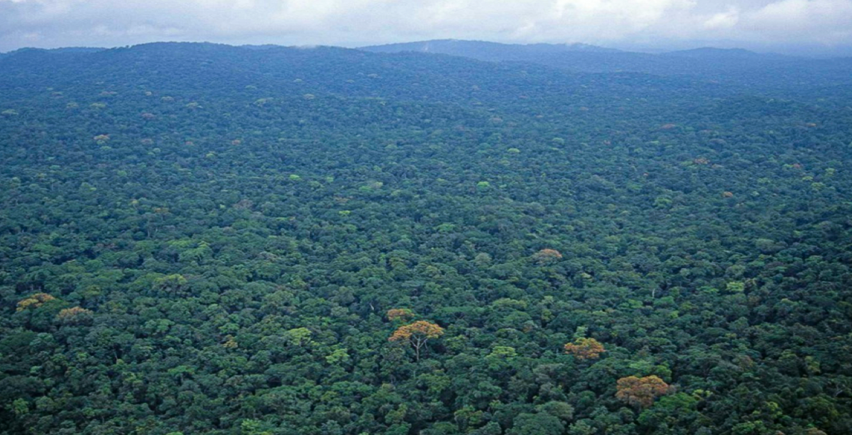
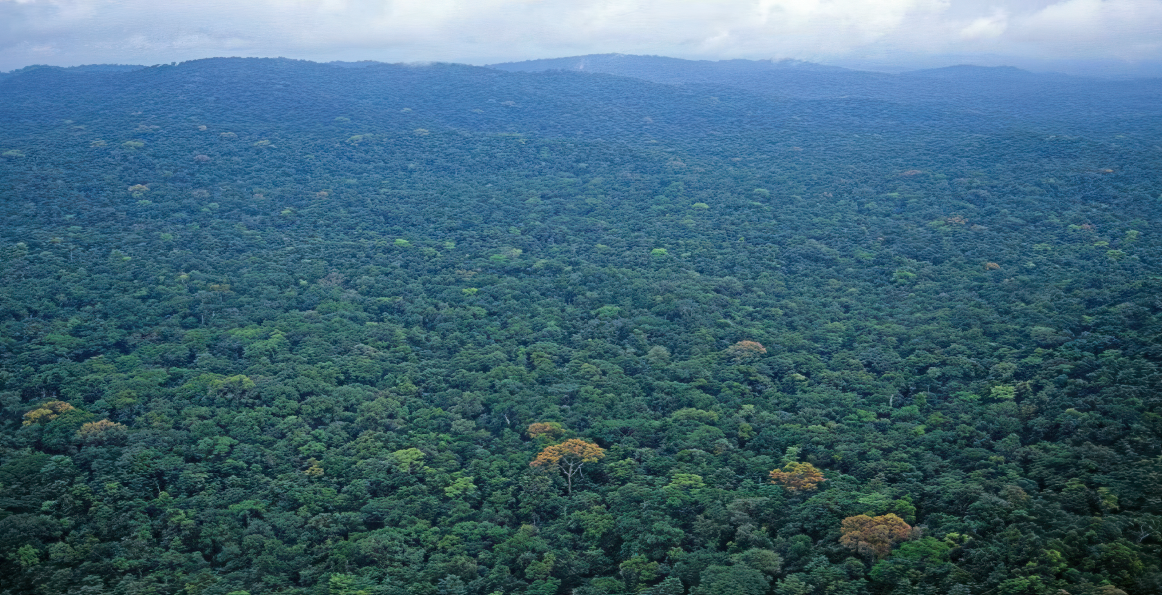
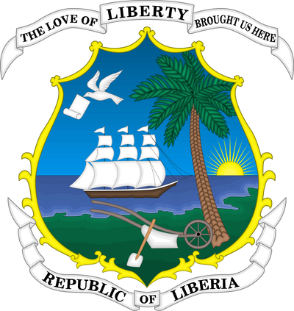

FORESTRY DEVELOPMENT AUTHORITY (FDA)
Meeting, November 3, 2025
Presented by: Mr. Nyaa-Lua Kapu

Slide 2
The Roles of Moa in Support of FDA’s Agenda In Sustainable Forestry

Slide 3
Introduction
Historically, forests have been a cornerstone of human development in the following ways:
- Resources (food, timbers, medicine)
- Services (others: clean air, water, pollinators, floor control etc.)
However, the Ministry of Agriculture is committed to supports the FDA goals in obtaining the Theme “Leveraging Liberia’s Forest for Economic, Social, and Environmental Sustainability” through Agroforestry.
The Agroforestry approach is coined in the National Agriculture Development Plan for integrating sustainable agricultural practices.

Slide 4
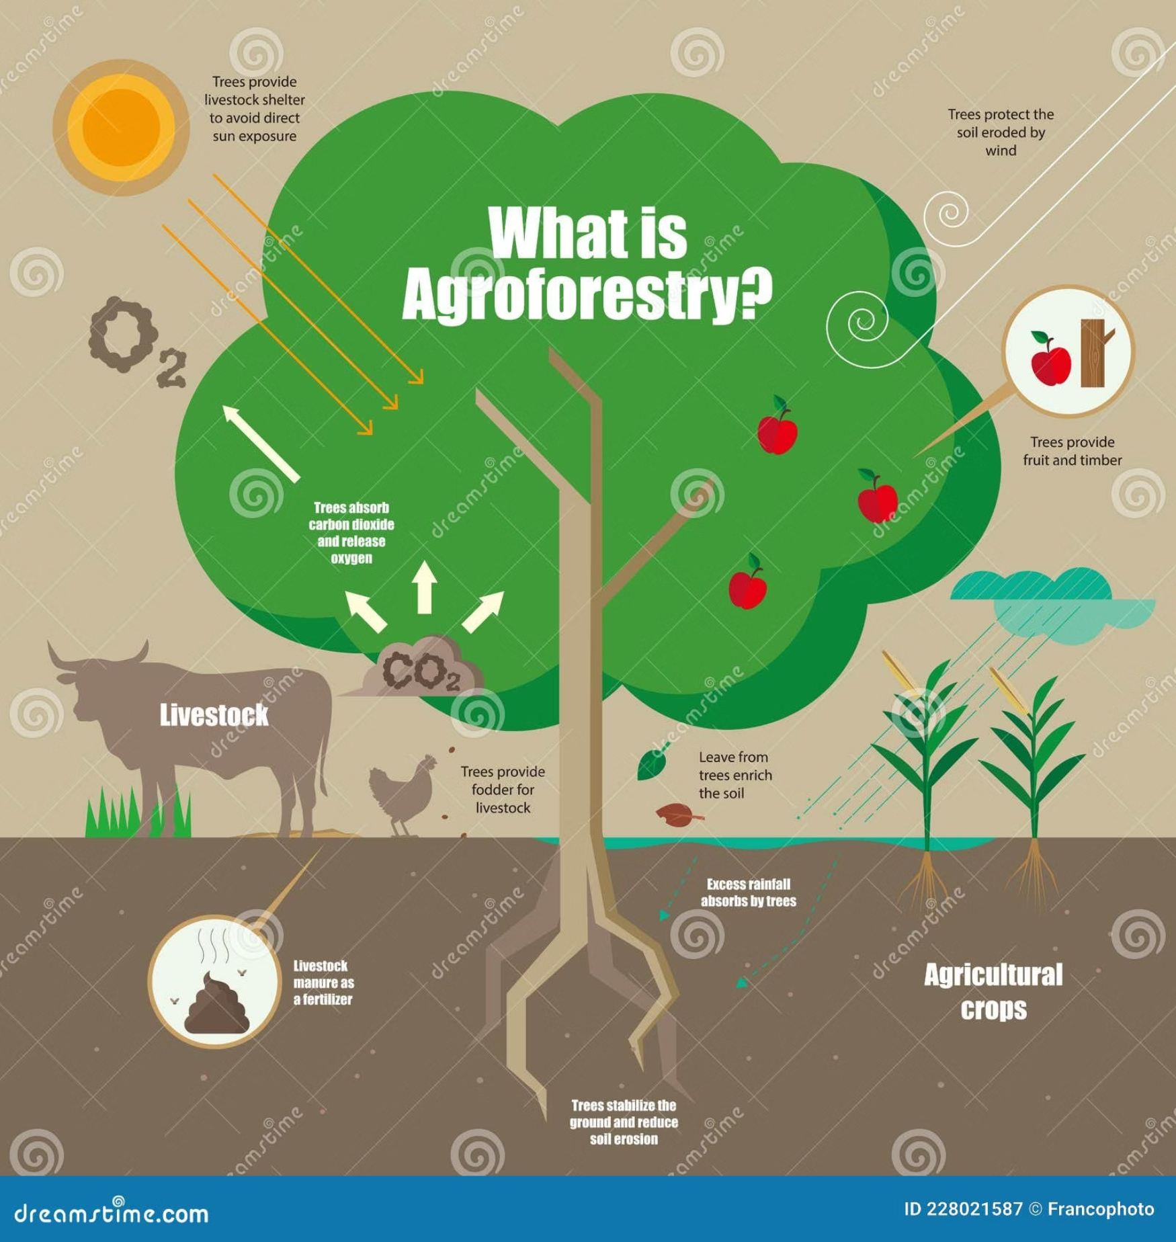
Why Agroforestry? A strategic Pillar for sustainability
Agroforestry elegantly integrates trees, cash crops, field crops and livestock systems, creating synergies that enhance productivity and environmental health while maintaining forest cover.

Slide 5
Agroforestry’s Objectives within the NADP Context
Increase Tree Population
Systematically prevent the removal of high canopy trees and intercrop cash crops with field crops.
Increased soils fertility and prevent erosion.
Increase investment return streams for women and youths.
2. Promote sustainable land use:
Approaches carry out to prevent deforestation and enhance ecosystem functions and services,
3. Transformation of farming methods:
Transition from shifting cultivation to mechanized farming and intercropping which have socio-economic benefits.

Slide 6
Socioeconomic Benefits Highlighted in the NADP
Enhance Food Security
Youth & Women Empowerment
Agroforestry improves food security, enables income diversification for smallholder farmers through multiple harvest streams during the year.
Creates meaningful employment opportunities and supports cooperative farming models that specifically empower youth and women, driving inclusive economic growth

Slide 7
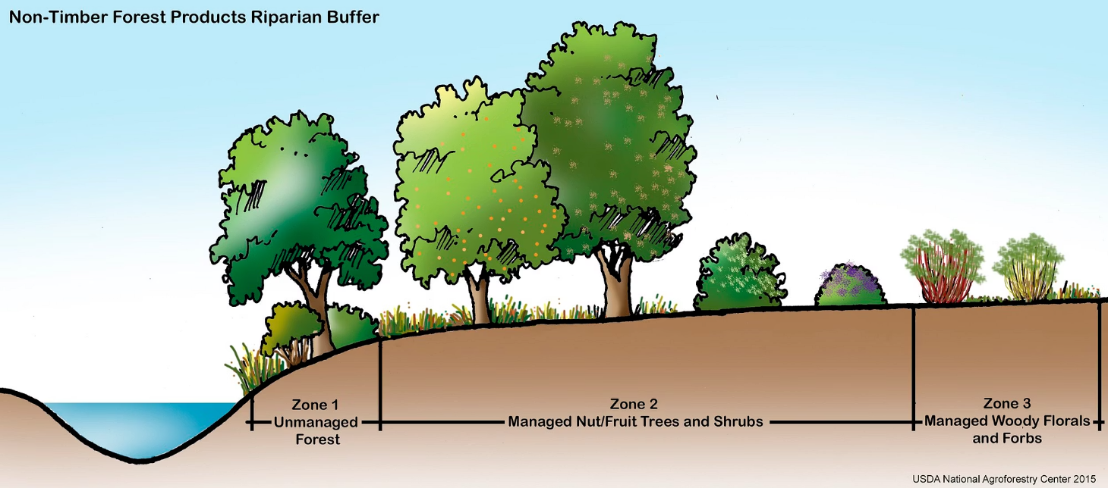
Climate Commitments
This approach perfectly aligns with Liberia's international commitments to climate-smart agriculture and carbon sequestration, positioning the nation as one of the climate leader in West Africa.

Slide 8
Agents to Drive the Change:
MOA, CARI
International partners
Private sector

Slide 9
Political Will
The driving assumptions include political will for environmental sustainability, through stakeholder participation in sustainable practices.
The expected results include sustainable cocoa, cashew, coconut and coffee production, biodiversity conservation, and protection of natural forests.
This aligns with government policies focused on environmental sustainability and poverty alleviation.

Slide 10
Conclusions
Agroforestry is the cornerstone of Liberia’s Agriculture future.
When agriculture thrives through agroforestry, Liberia's nation prospers—no one goes hungry, and the Lone Star shines brighter
Agroforestry under the NADP framework represents the critical intersection of food security, economic growth, and environmental sustainability—three pillars essential for Liberia's future prosperity
A United Call to Action
This vision requires collective commitment from farmers, investors, policymakers, and communities to build a resilient, self-reliant Liberia that serves as a model for sustainable development in West Africa.

Slide 11
Thanks !

